Slide 1


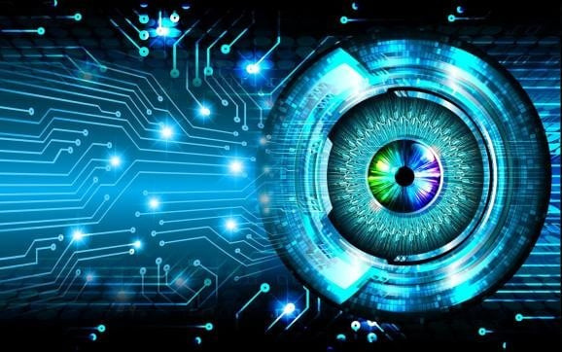

COMPUTER
VISION
Presented by: Sunder & Remya

Slide 2

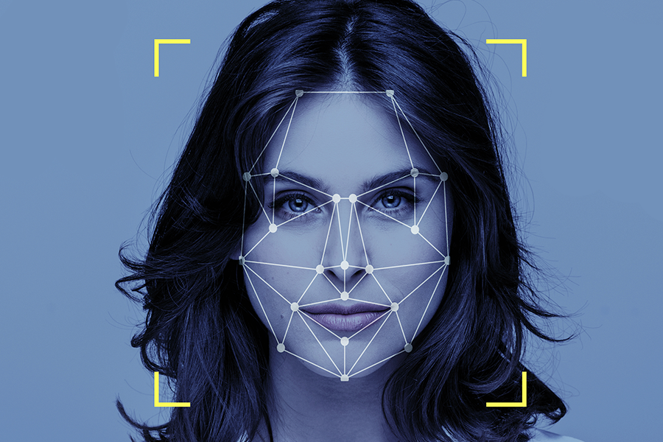




OVERVIEW
01
02
03
Introduction
Installation
Read&Display Image
04
05
06
Image Manipulation
Video Capturing
Conclusion

Slide 3

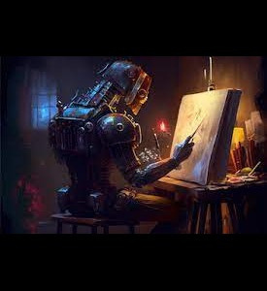
INTRODUCTION
Computer Vision is a field that includes methods for acquring,processing,analyzing and understanding images.
Image data can take many forms , such as a video sequence , depth images , views from multiple cameras , medical scanners , satellite sensors etc

Slide 4


Artificial Intelligence
Computer Vision
Machine Learing
NLP(Natural Language Processing)

Slide 5

OPEN CV
OpenCV provides wide range of tools for computer vision applications. It offers a common infrastructures for tasks such as image and video processing , object detection , machine learning and more. It is an open source code accessible for anyone to use and modify.

Slide 6

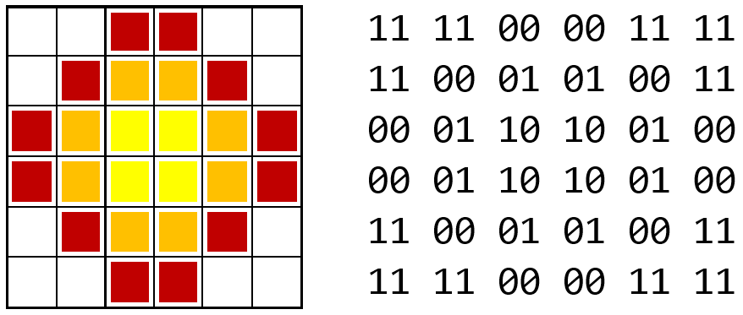
HUMAN VISION VS COMPUTER VISION

Slide 7
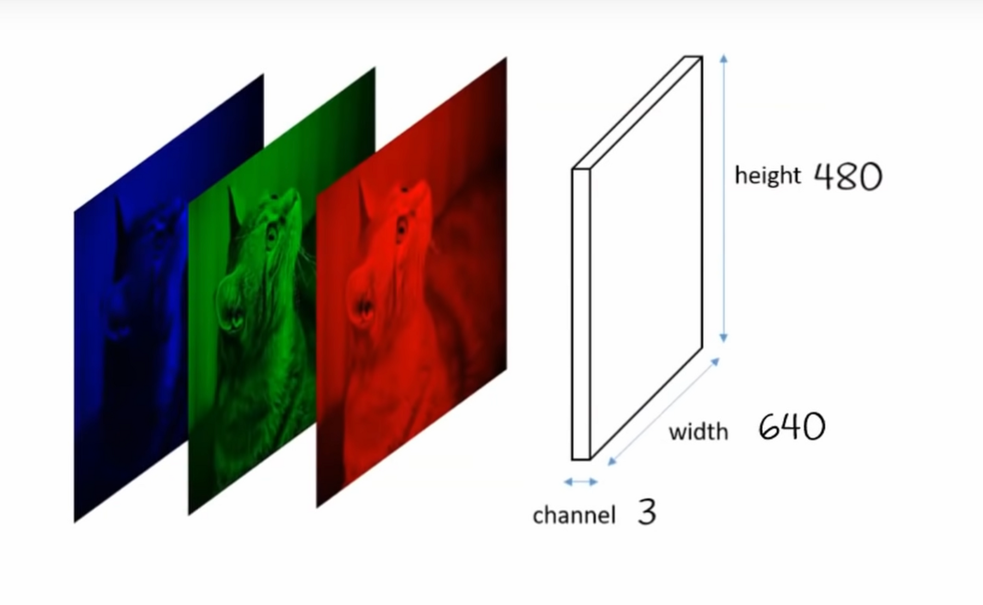

Slide 8
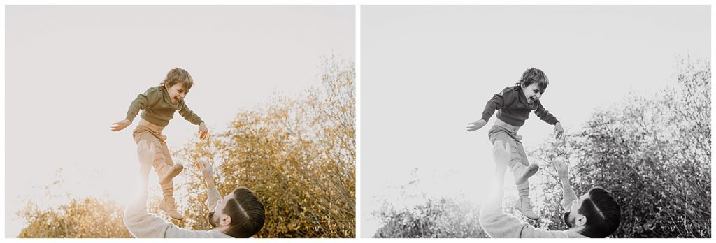
Changing Color-Space

Slide 9
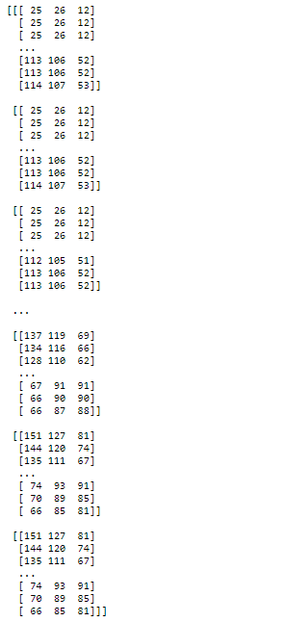

How OpenCV reads an image
Original Image

Slide 10
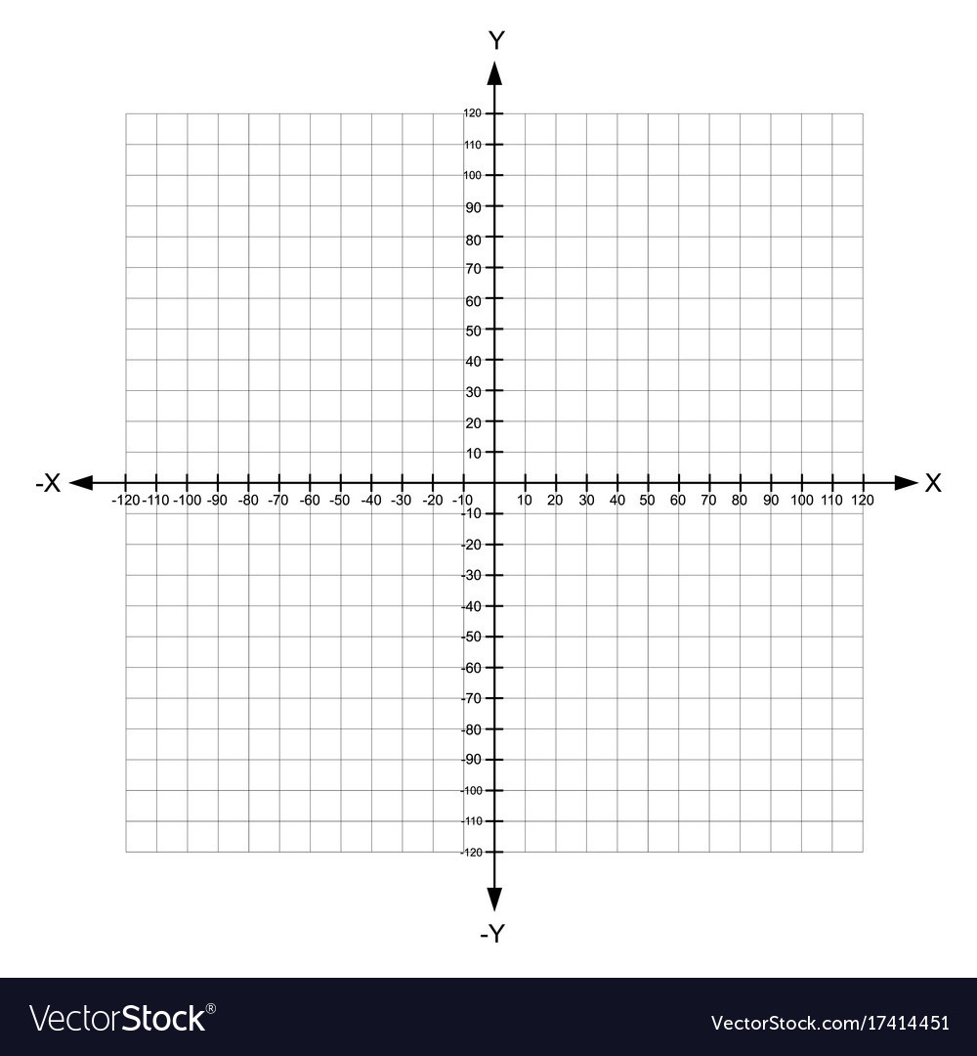

Slide 11
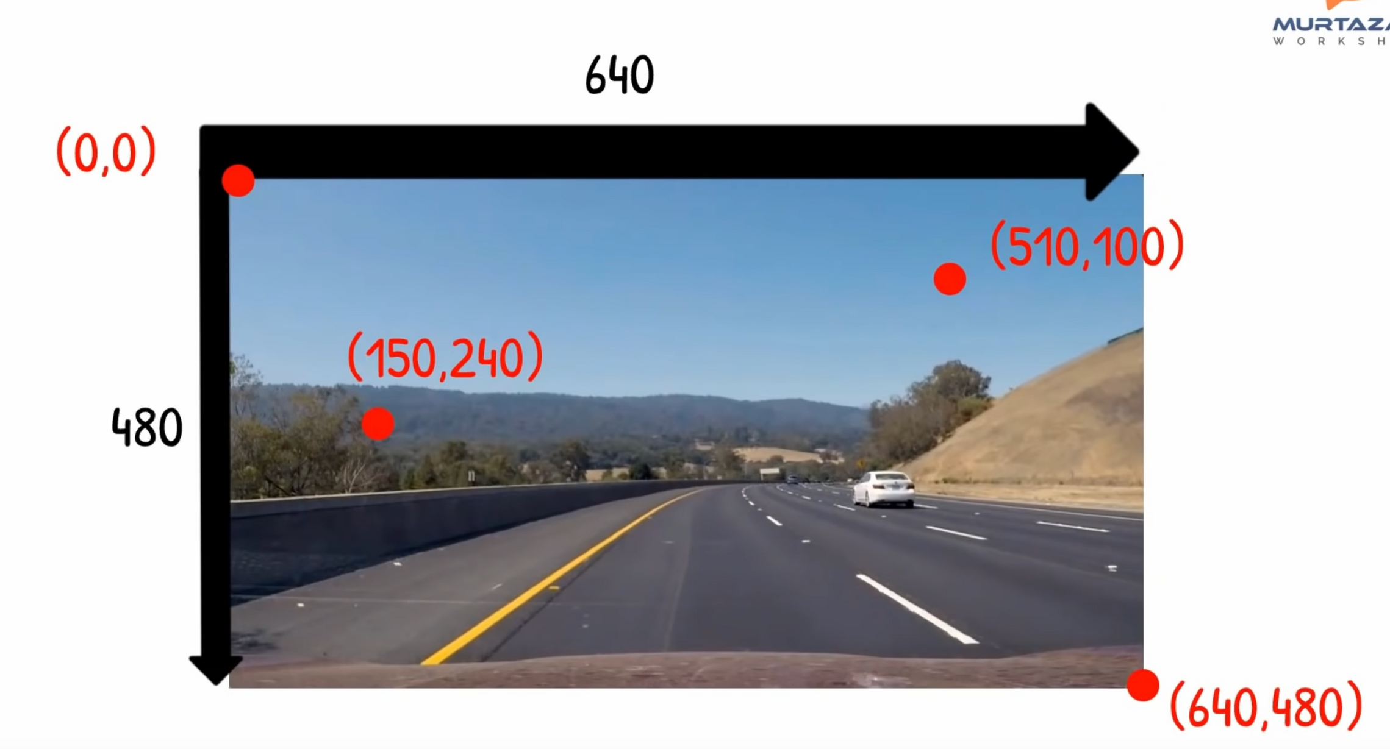

Slide 12
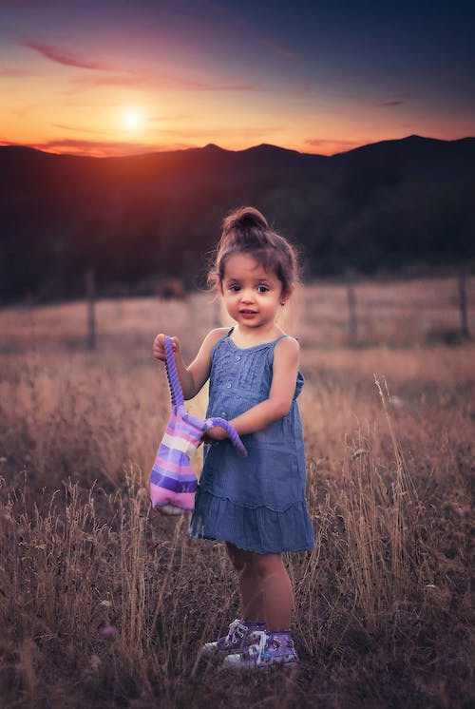


Draw shapes on Images
cv2.rectangle(
img = cv2.imread(“image.jpg”),
pt1=(100,200),
pt2=(500,700),
thickness=3,
color = (0,0,255),
)

Slide 13
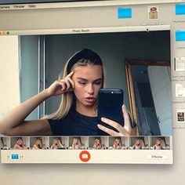

Video Capturing and Face Recognition Using OpenCV

Slide 14


Thank You
Connect with us.
Ph : +91 8300251244
Email : hr@clovion.org
Web : https://clovion.org
Feedback : https://clovion.org/Feedback_Form.php

